Slide 1
Pre-Feasibility Report Project Update
Hinton Geothermal District Energy System
February 2017
Epoch Energy

Slide 2
Agenda
Overview
On Scope/Timeline: Work to Date & Team
Upstream:
Geological Review & Reservoir Selection
Well Selection Criteria & Solutions
Midstream:
Direct Heat Facilities
From Wellhead to Distribution of Heat Supply
Downstream:
Heat Flow Requirements to Facilities
Surface Infrastructure & Design/Costing
Financial Modelling
Ongoing Project Management
Government & Community Dialogue
Contracting & Funding

Slide 3
The Opportunity
Hinton Geothermal District Heating Project
Use plentiful geothermal energy to replace natural gas and electric heating of the significant buildings in town
Work with the Oil and Gas companies in the area
Put workers back to work
Reduce CO2 emissions and escalating carbon taxes
Hedge future commodity costs (Natural Gas and Electricity)
Bring competitive advantage to the community
Foster new industries like greenhouse food production
Build a replicable business model for other Alberta communities and first nations

Slide 4
Project Overview
Pre-feasibility Study for Hinton Geothermal Direct Heat Project

Slide 5
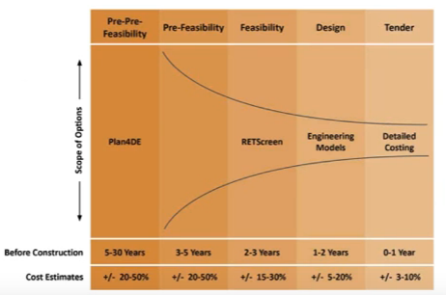
Timeline for Project Development
Engineering timeline: Pre-feasibility to Completion = 3-5 years on average
Availability of data and pre-existing infrastructure aids development
2020 timeline for project completion
Direct Heat project for >100,000 GJs of energy interconnected into direct heat customers aligns with carbon taxing at $50/ Tonne of CO₂

Slide 6
Project Scope for Pre-Feasibility
Upstream: Geothermal Resource Production
Research/data mining for geothermal formations/resource potential & reservoir capacity
Well analysis and cost analysis for viable for geothermal energy production
Engage oil and gas operators of wells
Midstream: District Energy System
Design & cost Estimate of HGDE and distribution system
Identify risks/opportunities with facility options and locations
Address regulatory requirements & schedule
Downstream: Customer Energy Services
Interconnection and tier of prospective customers
Identify thermal load and load profile: Design & Cost Analysis
Energy Efficiency and GHG calculations
Project Financial Assessment
Pretax unlevered financial analysis for overall project design

Slide 7
Technical Team for Pre-Feasibility Study
Epoch Energy
Enerpro Engineering
Williams Engineering
Stack’d Consulting
Software
Direct heat modelling
GeoScout/AER Data
Geology team:
Petroleum
Hydrogeologist
Geothermal/Heat flow modelling
Engineering:
Reservoir
Drilling Completions
Abandonment
Facilities/Pipelines
Building

Slide 8
Upstream: Geology for Geothermal

Slide 9
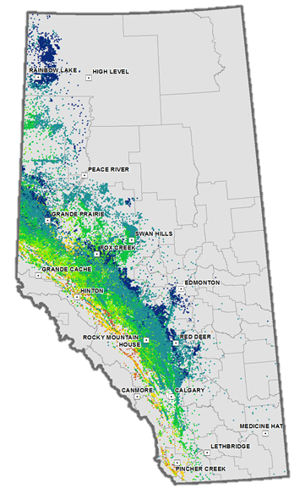
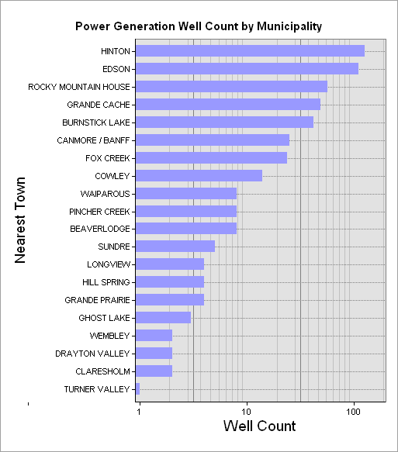
Foothills Geothermal Potential
Rocky Mountain foothills: area of high relief, high hydraulic head and regional water recharge.
Extensive database for the numerous 3-4km TVD oil & gas wells
Map: Oil and Gas wells with Bottom Hole >60⁰C Temperatures (BHT)
Notes:
Why the Canadian Foothills?
It’s an area of high relief, high hydraulic head and regional water recharge. As flow is one our key issues, this area is a good fit for geothermal.
The vast number of wells, means we have options and knowledge about the area, and some of the necessary infastructure. Extensive reservoir engineering has been done on the area, we know porosities, water chemistry, stuctural. It’s been studied and researched and studied some more. If it’s possible we may have too many sources of information.
The most important attribute to the foothills is heat. We have bottom hole temperatures above 140 C, we have hot water and rocks at depth, and we have access to that heat source.

Slide 10
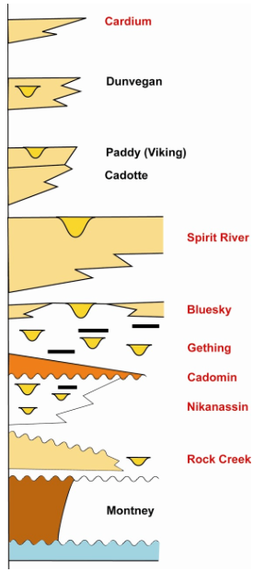
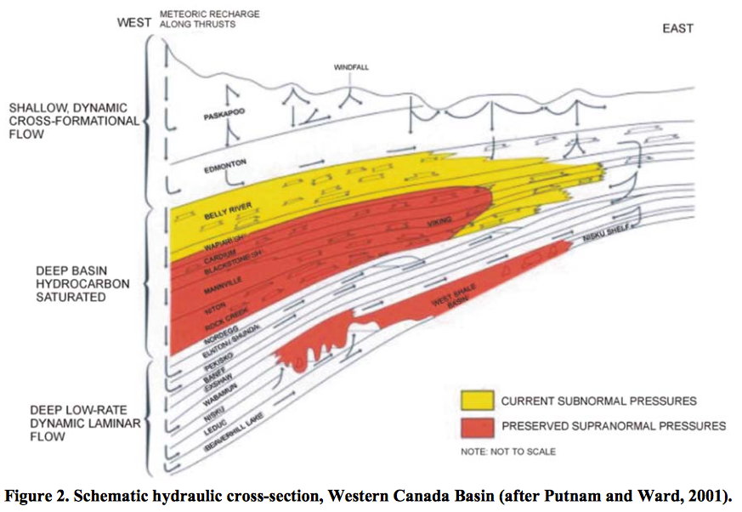
Geology: Petroleum View
Producing formations are typically hydrocarbon-charged, tight, & over-pressured
Where porosity is developed, reservoirs are more likely to contain water in the absence of a conventional trap
Typical Deep Basin Producing Formations
Notes:
The Deep Basin - A Hot ‘‘Tight Gas’’ Play for 25 Years*
By Brad J.R. Hayes1
Search and Discovery Article #10050 (2003)
The Deep Basin Development Entity – Enhancing
Exploitation of Alberta’s Deep Basin Tight Gas Resource
Brad J. Hayes

Slide 11
Upstream: Well Selection Analysis

Slide 12
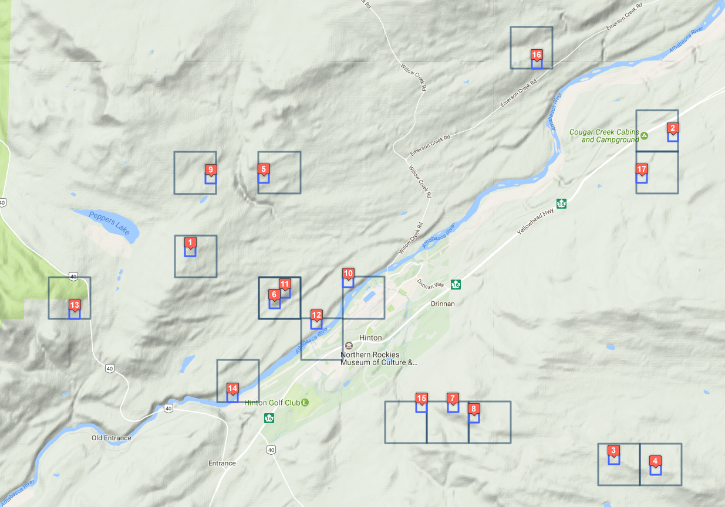

Upstream: Well Analysis & Selection
Accumulating extensive data set for well selection: GeoScout, AER, personal research…reviewed >100 wells
Began analysis & key variable for geothermal applications:
Status (Abandoned, Suspended, active…)
Well date/age & current conditions
Design: Casing, tubulars, liners…
Well work to date: DST, well logging, stimulations…
Current ownership
Proximity to other wells & infrastructure
Process has filtered down to ~15 wells with geothermal potential in close proximity

Slide 13
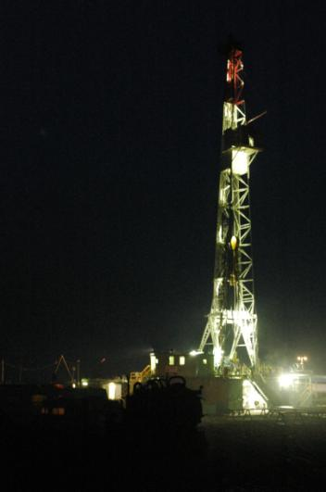
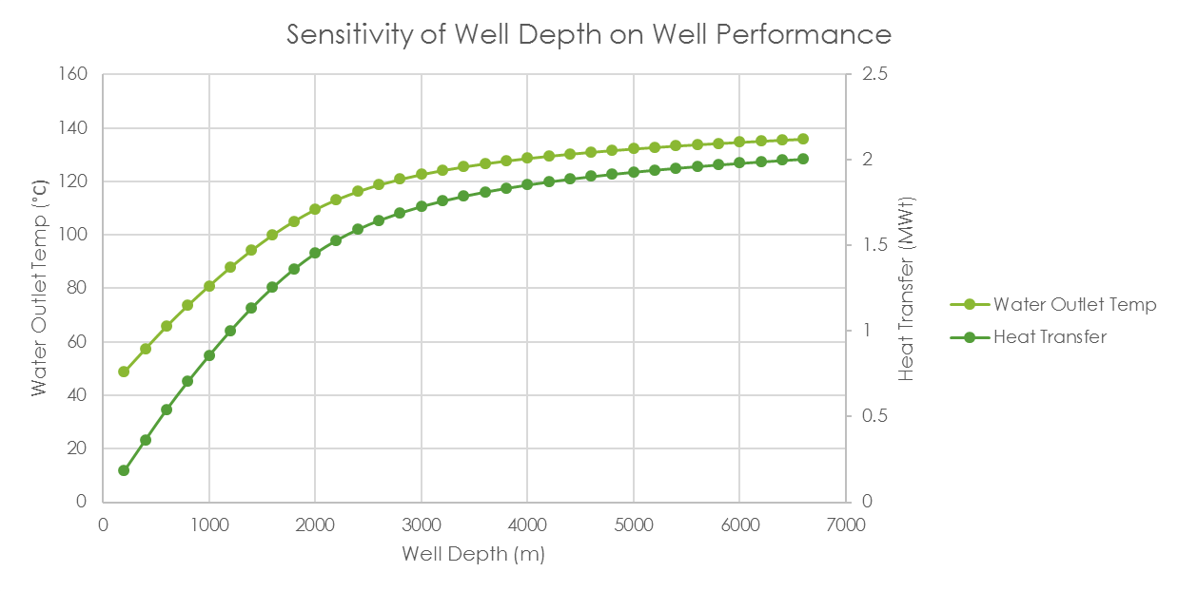
Second life for Oilfield wells
Epoch in ongoing communication with local oilfield operators
Well intervention & reconfiguration is fraction of the cost of new drilling
Researching necessary work to re-complete wells for geothermal production
Removing cement plugs & casing
Downhole pumps
Well stability & corrosion
Service rig time…
Final product: calculation of overall costs/risk associated with multiple well selections & re-configuration for geothermal production
Notes:
So we have a project area, with deep wells and hot water resource. How can this be more than cost-effective than conventional project.
Current geothermal drilling projects are between 1.5-2 million for a 1-2 km production hole. This is a significant chunk of the overall production costs for a project. This also requires that the bulk of the costs for any geothermal project occur at the onset of the project. You need to take all your capital and risk at the beginning, this makes investors a little ‘gun-shy’, as you haven’t yet proven the resource. This front-end heavy system with a long-term payout has prevented significant investment in geothermal in the past.
If the resource is already proven, ie bottom hole temperature and flow, it’s a matter of reconditioning the abandoned well for a geothermal application. This will require on site work like removing cement plugs, installing downhole pumps, ensuring well stability, and checking the condition of casing. The smaller hole size will likely reduce overall flow, but the well re-conditioning costs will likely run between $50,000 and $200,000 for a 3-4 km hole in the Hinton area, a tenth of the cost of drilling a 1-2km well in an area of higher geothermal gradient.

Slide 14
Midstream: District Heat Design

Slide 15
Midstream: District Energy System

Slide 16
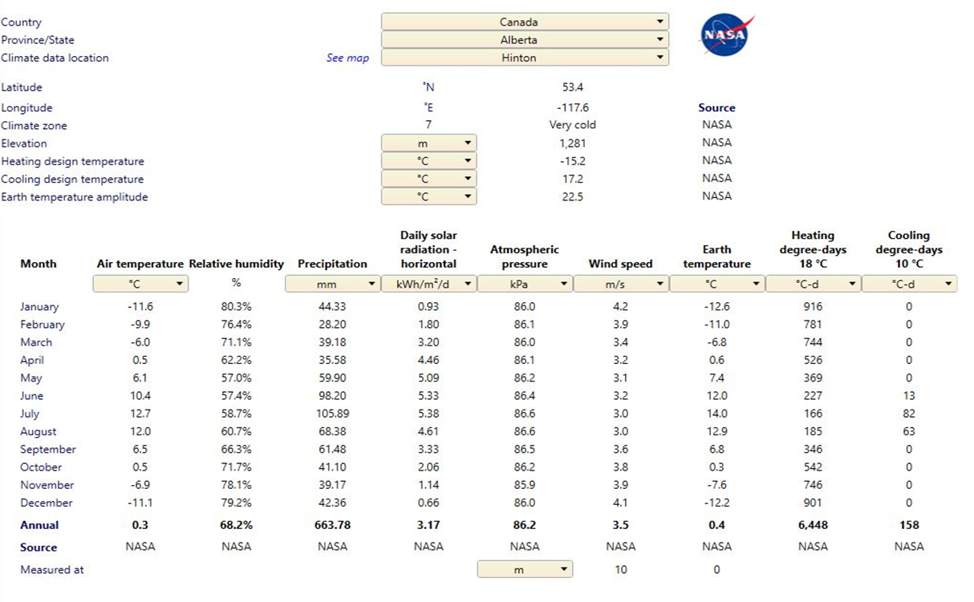
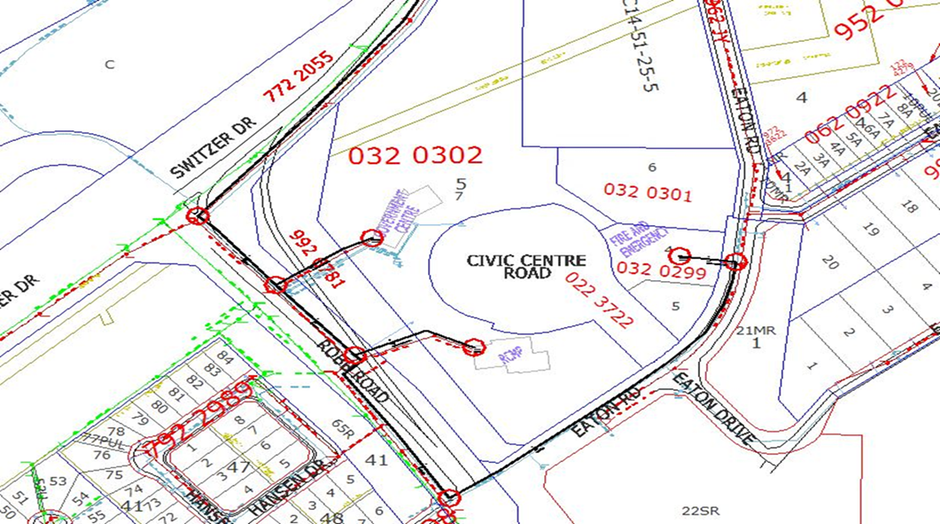
Midstream: Engineering Direct Heat Facility
Heat Distribution
Gathered atmospheric data
Gathered project data to determine heat loads
Gathered regional data (basemaps)
Created preliminary network model
Preliminary sizing of transmission and distribution piping
Developed strategy utilizing a substation with multiple inputs (multi-well, waste heat recovery, biomass, etc) for redundancy and future proofing

Slide 17
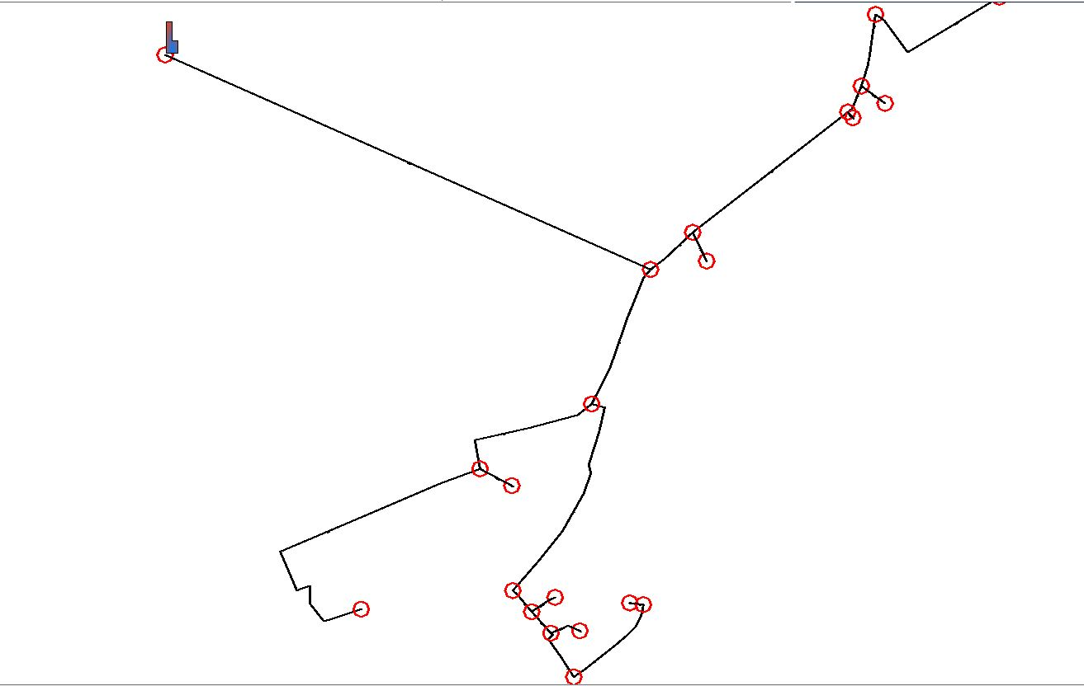
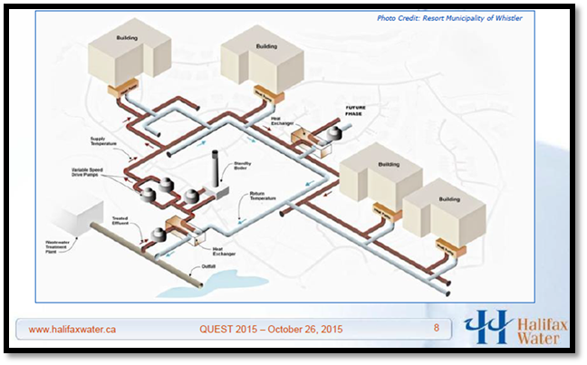
Midstream – Heat Distribution Network Model with Substation and Nodes
Use of unique heat flow software for mapping and cost analysis

Slide 18
Downstream: Direct Heat Customers

Slide 19
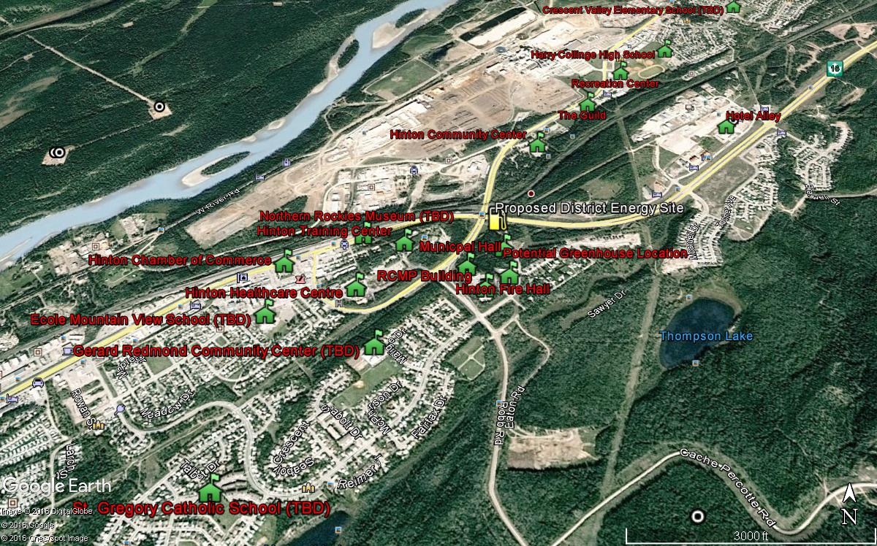
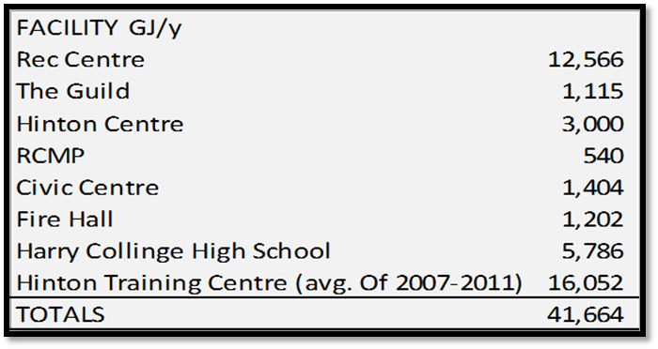
Downstream: Mapping Customers
Initial Analysis
Calculated peak of ~3MWth
40,000’s GJ/s year for current list of customers
Building interconnection methods
Cost analysis for each potential scenario

Slide 20
Downstream Engineering
Building Engineering
Williams Engineering have reviewed all the building (except the HTC and Senior Complex)
Creating a baseline GHG factor per square foot based on age of building
Reviewing energy retrofit feasibility
Integration Engineering
Sizing heat exchanger and heat meter for individual buildings
Integrating District Energy System (DES) into individual buildings
Potential retrofitting of existing boilers
Potential retrofitting of system to accommodate DES

Slide 21
Financial Modeling
Economic analysis of long-term project viability
Levelized Cost of Energy and comparison with Natural Gas
Full Greenhouse Gas reduction calculations

Slide 22
Financial Modeling
Calculating the avoided cost of carbon
Forecasting the Business As Usual (BAU) case vs the DES model for economic feasibility
Input of Total Installed Capital (TIC) costs from Upstream, Midstream and Downstream to financial model
More of this will be done once costs have come in

Slide 23
Project Next Steps
Non-technical Activities (Dialogue and Progress)
Completion of Pre-Feasibility Report
Local presentations
Feedback from Ministers and AER
Any updates from Epoch Corporate activities

Slide 24
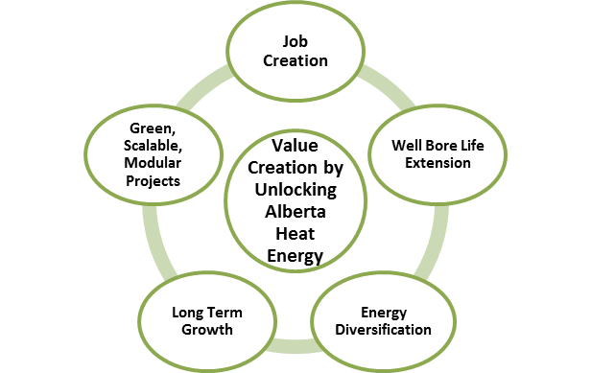

Project Benefits
Local source of clean renewable heat supply
Significant untapped resource potential
Long-term stable ‘non-commodity’ base heat pricing
Community based project
Reduce GHG associated with Natural Gas heating
Opportunity for positive, ‘green’ marketing
Potential for delayed well suspension & abandonment

Slide 25
QUESTIONS? Hinton Geothermal Project
Epoch Energy
Info@epochEnergy.com

